Slide 1

You Can Run but You Can’t Hide

Slide 2

$whoami
Research Scholar (Ph. D.) @ NFSU
Talk to me about:
Security
Forensics
Everything Computer Science
Full-time foodie
Anime enthusiast
Security Engineer @Qualys

Slide 3
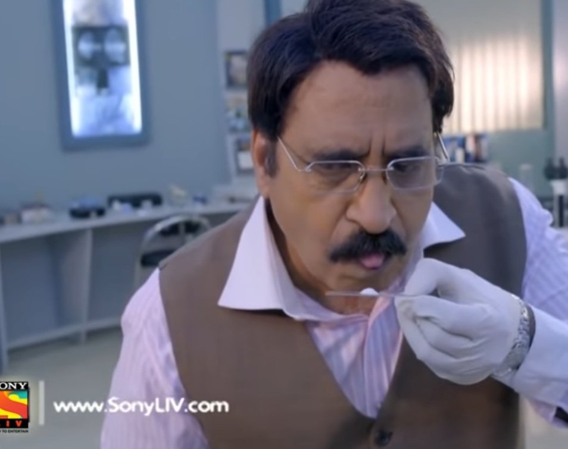
What is Forensics?

Slide 4
Forensics is...
The process of Identifying, Recovering, Preserving, and Analysing Digital Evidence

Slide 5

What do you mean?

Slide 6
Okay. Let’s break down all the points.
Identify
Artefacts
Acquire
Artefacts
Preserve
Artefacts
Connect
Related artefacts
Create
Graph of connected artefacts
Establish
Timeline of events/actions/processes

Slide 7

That’s it?
From a bird’s eye view, yes
However, things become exciting quickly
Was a file deleted or renamed or moved to a different folder?
Did someone run a malware?
Did someone delete all your event logs?
What about overwritten file and its old content?

Slide 8

Use cases
Recover accidentally deleted that movie from your pen drive
Rebuild flight trajectory of a crashed flight
Recover commands executed by Alexa to support an alibi

Slide 9
Some more use cases
CPU and Network activity spikes in server - Crypto mining malware
Spy smuggles important docs in Alternate Data Streams in USB
Intern deletes production DB

Slide 10

Bottom line
Digital Forensics is the deeper understanding of the way digital devices work, so that data can be extracted out of them, analysed, and presented without bias.

Slide 11

Forensics is a broad domain….
So, let’s narrow things down.
Let’s just focus on some fundamentals.

Slide 12
Where do we store most of our data?
File Systems
Well….. not us directly. But it eventually goes there

Slide 13
About today’s topic …..
File Systems
Design a Simple File System
Where do deleted files go?
Live Coding – Carving Deleted Files

Slide 14
NOTE
There’s a difference between file carving and file recovery
Please do not mix these terms
Long story short – file recovery is file system specific

Slide 15

What’s a File System?
Software?
Hardware?
An Algorithm?
A Concept?
A Data Structure?

Slide 16
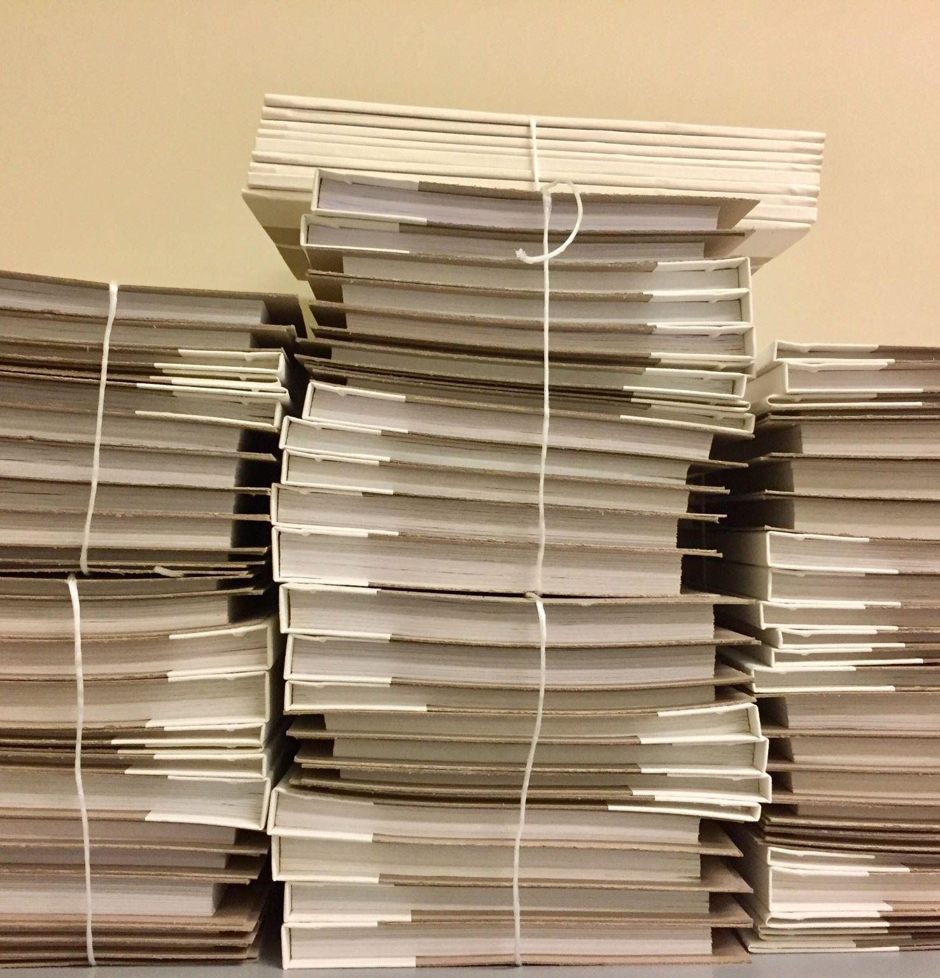
What’s a File System?
File system is a data structure – a blueprint that describes how files on must be organised on the device.
Think of it as a cabinet that allows you to organise all your files.
At a high level it is analogous to JSON. While they serve different purposes, both are designed to organise data in a certain format.

Slide 17
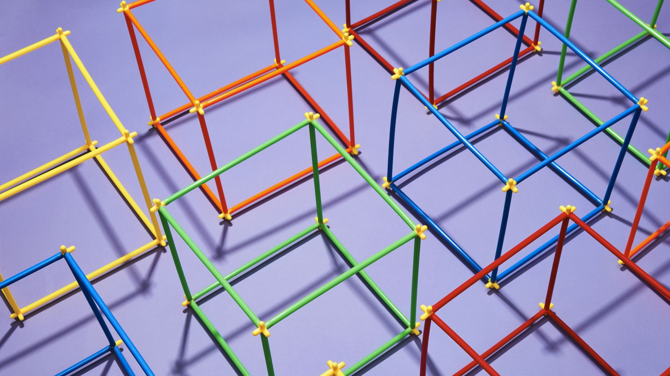
Types of file systems
Disk Based
Network File Systems
Distributed
Embedded
Transaction Based
Virtual
Clustered
Log Structured

Slide 18

Some disk-based file systems
NTFS
exFAT
EXT4
XFS
ZFS
ReFS

Slide 19

What’s a File?
Just an array of bytes lol
Let’s not go to deep into it for now

Slide 20


Slide 21
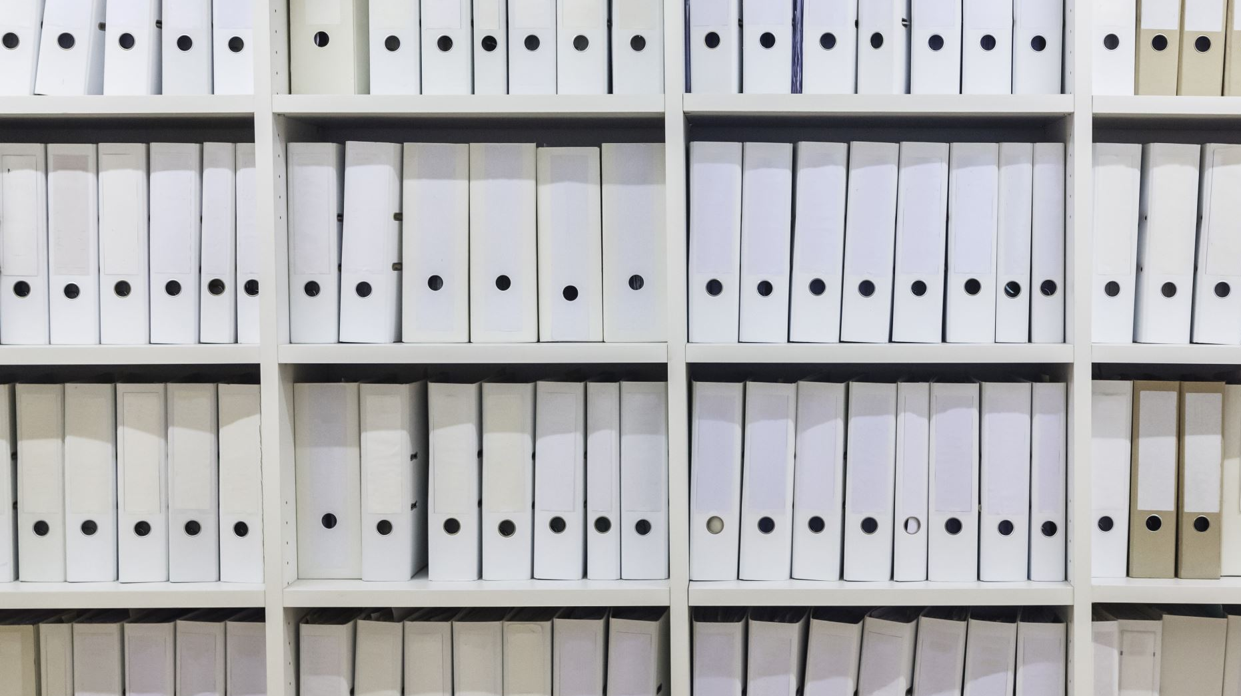
Let’s design a simple file system
We’ll call it `kaappi`
Finnish word for Cabinet
Objectives to understand
File indexing
File deletion
File fragmentation
Feel free to use this design to make your own file system ^.^

Slide 22
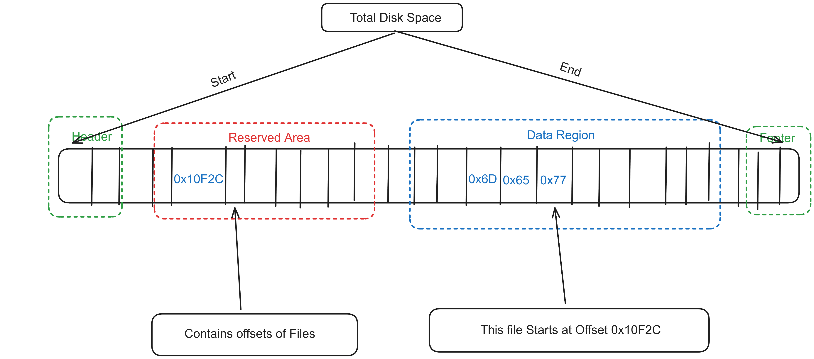
kaappi

Slide 23
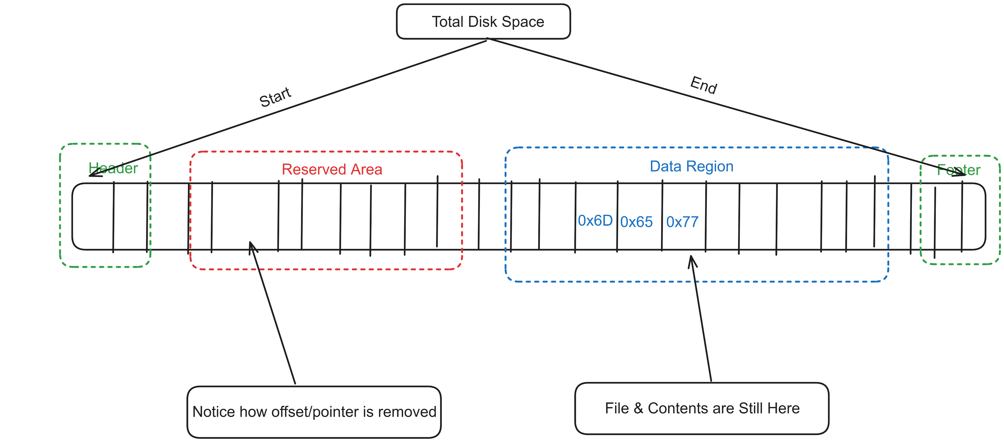
Where do deleted files go?

Slide 24
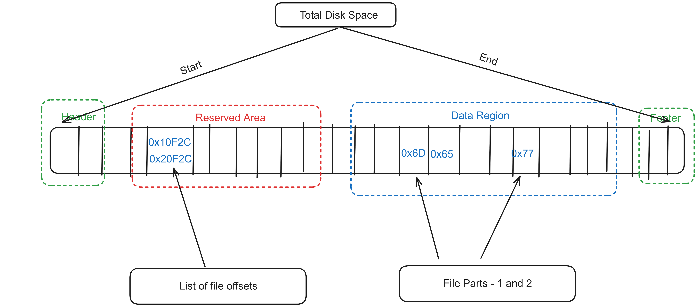
What about fragmented files?

Slide 25

Carving Deleted Files
Most of the files have a header and a footer
This header is called the “magic string” or “magic number”
We can look for this header and footer to find the deleted file
Remember – file still exists, only pointer was removed

Slide 26
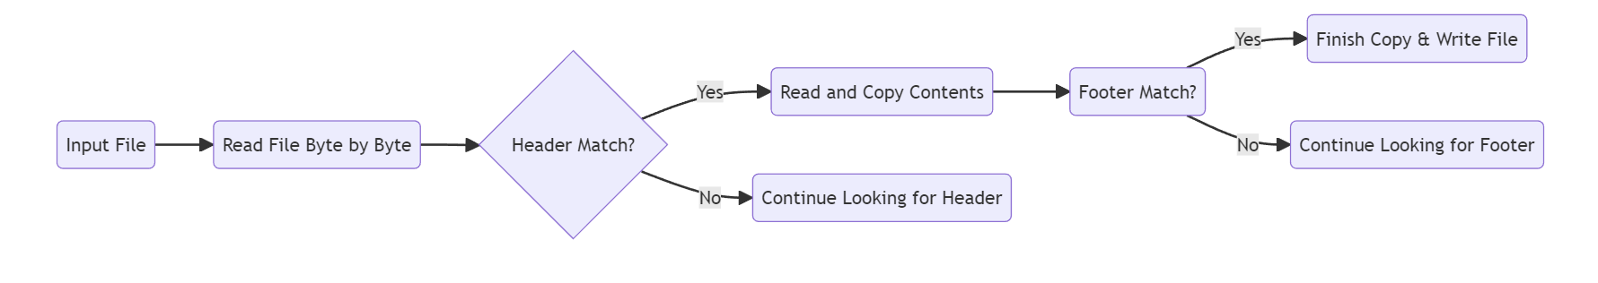
How do we do it?

Slide 27

It’s just pattern matching .-.

Slide 28


Slide 29


Time for Live Coding!

Slide 30

Caveats
This algo only works for files that can be loaded in RAM
Will carve out embedded files as well
Does not work for fragmented files
Requires a big DB of magic header and footer bytes

Slide 31

Isn’t there a better way to do this?
Header-Size Carving
File system specific – file/dir entries with “InUse” bit set to 0
Fragmented file detection
Sliding window pattern matching with buffered file IO

Slide 32

Code Link
https://github.com/gaurav-gogia/carvey_lite

Slide 33

Recommended Reading – Research Papers
An Introduction to the exFAT File System and How to Hide Data Within
Forensic Analysis of the exFAT Artefacts
A contemporary investigation of NTFS file fragmentation
Forensic APFS File Recovery

Slide 34


Slide 35
Bonus! Anti-Forensics
Over-write the same file 100 times before deleting
Remove Registry Entries
Don’t use Windows Explorer to open folders
Create your own file format – your own header and footer
Good ol’ steganography

Slide 36

Let’s Connect

